Slide 1

Back-End Development
End Term Project

Slide 2
Simple Blog Project
Name: Dhruv Garg
Roll no: 2010993755
Branch: BE-CSE-5th Sem
Group: G-24
Trainer: Madam Divya Goyal

Slide 3
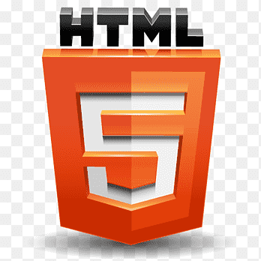



Technologies Implemented
Html
CSS, CSS3
NODE JS
EXPRESS

Slide 4
OVERVIEW
(about technologies)

Slide 5


REACT Js:
ReactJS is a declarative, efficient, and flexible JavaScript library for building reusable UI components.
It is an open-source, component-based front end library which is responsible only for the view layer of the application.
React-Js follows the Model View Controller (MVC) architecture, and the view layer is accountable for handling mobile and web apps.
React is famous for building single-page applications and mobile apps.
The main objective of ReactJS is to develop User Interfaces (UI) that improves the speed of the apps.
It uses virtual DOM (JavaScript object), which improves the performance of the app. The JavaScript virtual DOM is faster than the regular DOM.
We can use ReactJS on the client and server-side as well as with other frameworks.
It uses component and data patterns that improve readability and helps to maintain larger apps.

Slide 6
EXPRESS (NODE js)
Express is a node Js web application framework that provides broad features for building web and mobile applications. It is used to build a single page, multipage, and hybrid web application.
It's a layer built on the top of the Node Js that helps manage servers and routes.
Express was created to make APIs and web applications with ease, It saves a lot of coding time almost by half and still makes web and mobile applications are efficient.
Another reason for using express is that it is written in JavaScript as JavaScript is an easy language even if you don't have a previous knowledge of any language. Express lets so many new developers enter the field of web development.
The reason behind creating an express framework for node Js is:
Time-efficient
Fast
Economical
Easy to learn
Asynchronous

Slide 7

MONGO Db
MongoDB is an open-source document-oriented database that is designed to store a large scale of data and also allows you to work with that data very efficiently. It is categorized under the NoSQL (Not only SQL) database because the storage and retrieval of data in the MongoDB are not in the form of tables.
The MongoDB database contains collections just like the MYSQL database contains tables. You are allowed to create multiple databases and multiple collections.
MongoDB stores data in flexible, JSON-like documents, meaning fields can vary from document to document and data structure can be changed over time
The document model maps to the objects in your application code, making data easy to work with . MongoDB is a distributed database at its core, so high availability, horizontal scaling, and geographic distribution are built in and easy to use
Now inside of the collection we have documents. These documents contain the data we want to store in the MongoDB database and a single collection can contain multiple documents and you are schema-less means it is not necessary that one document is similar to another.
The documents are created using the fields. Fields are key-value pairs in the documents, it is just like columns in the relation database. The value of the fields can be of any BSON data types like double, string, boolean, etc.

Slide 8
Over View
(About topic)

Slide 9
Over View
(About topic Project)

Slide 10
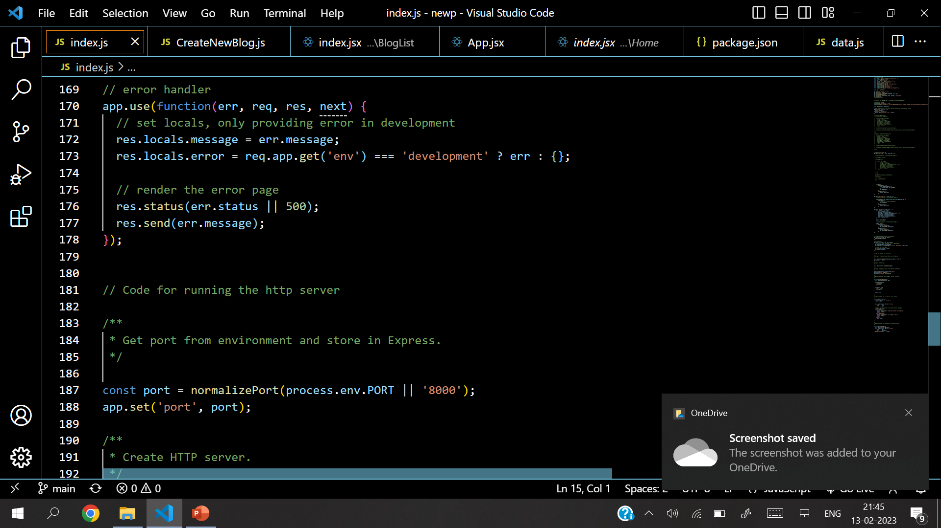
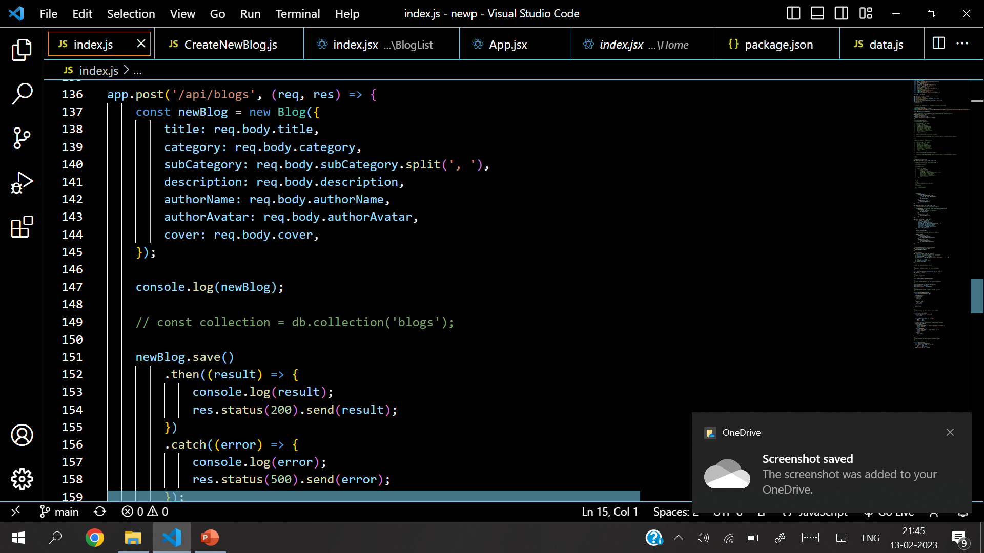
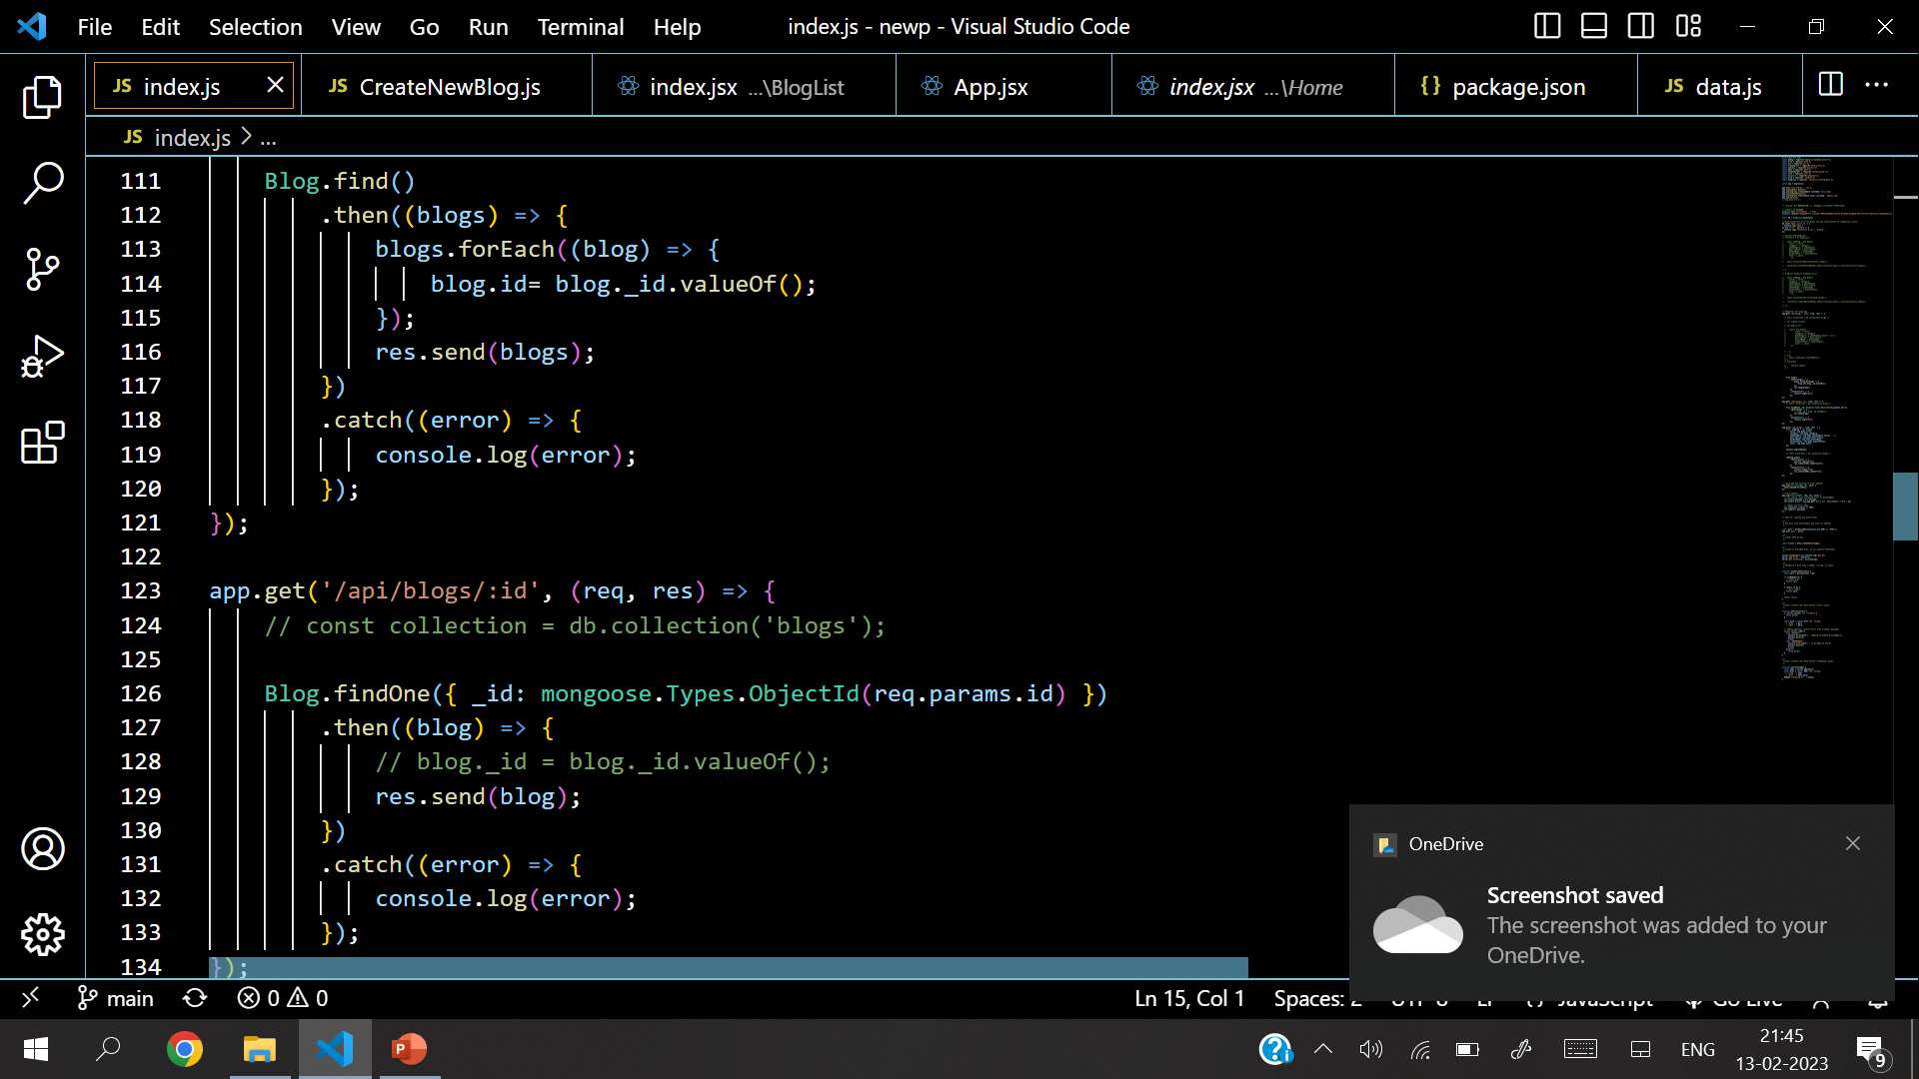
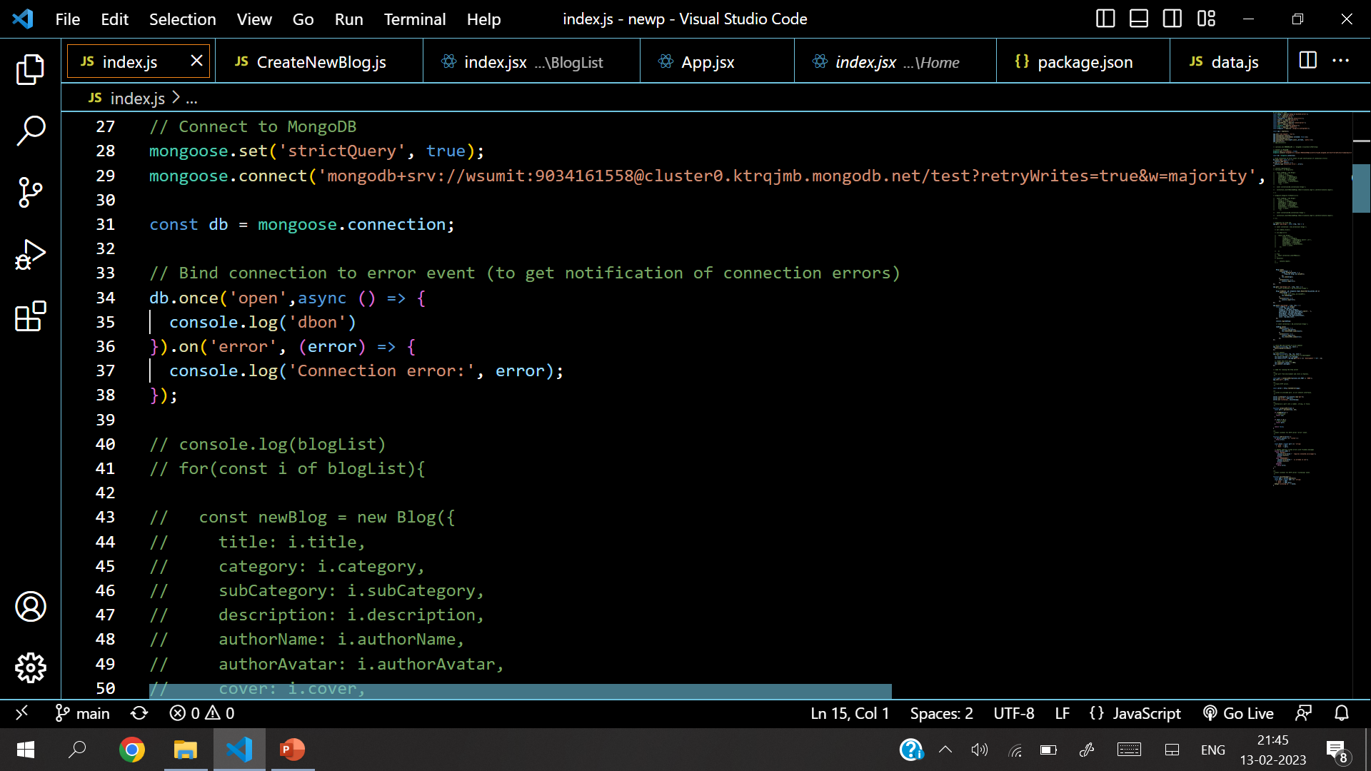
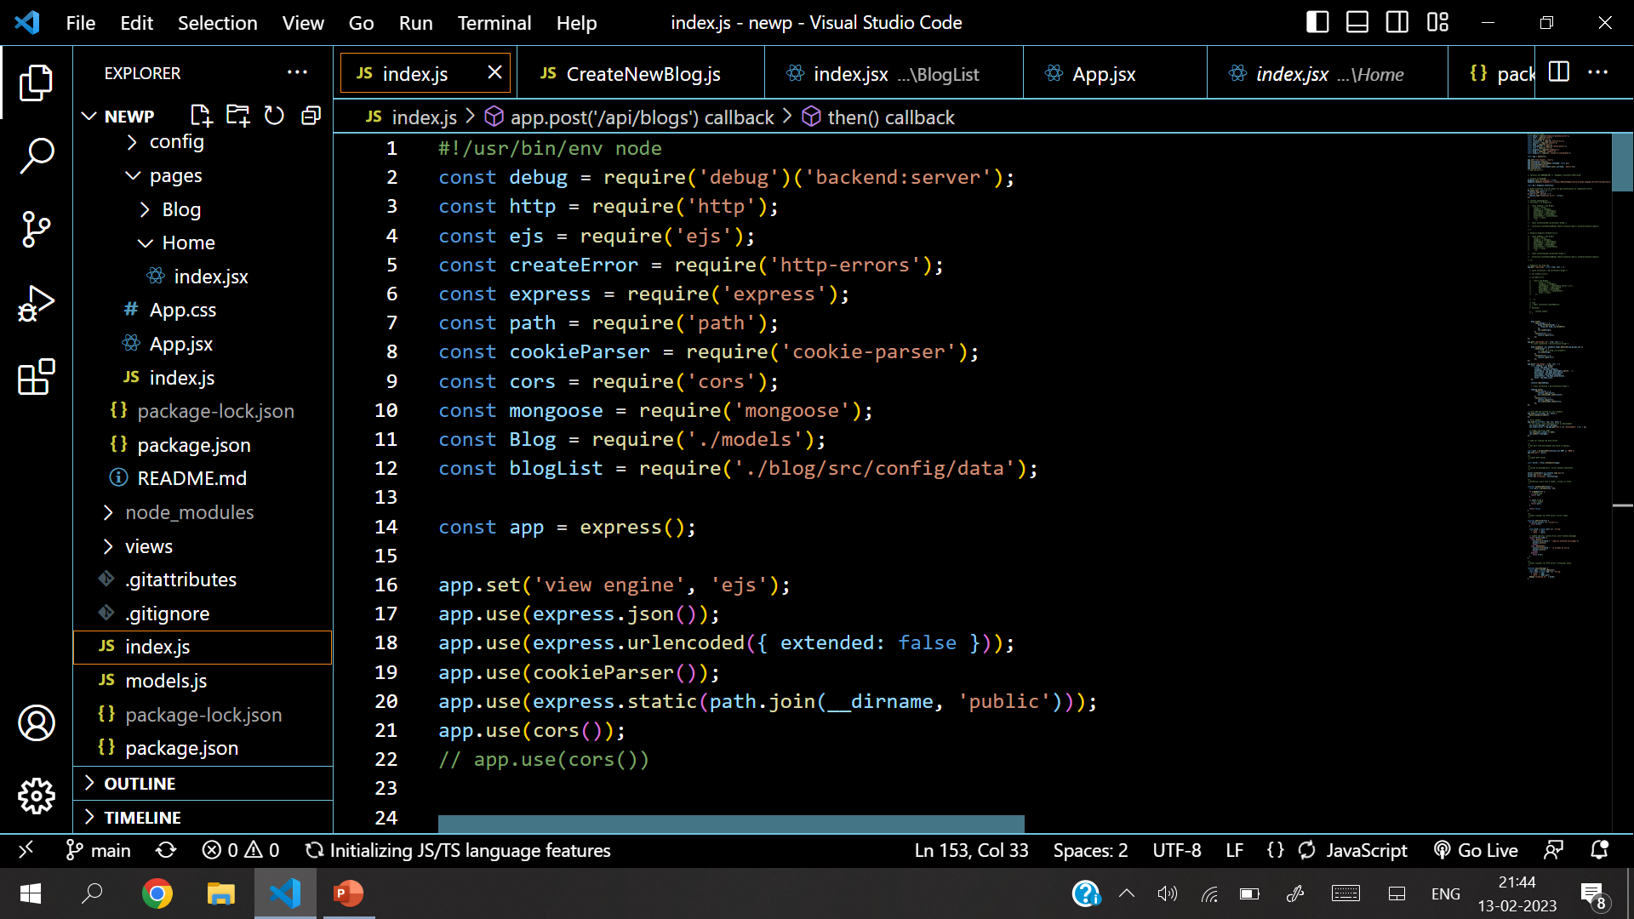
Source Code

Slide 11
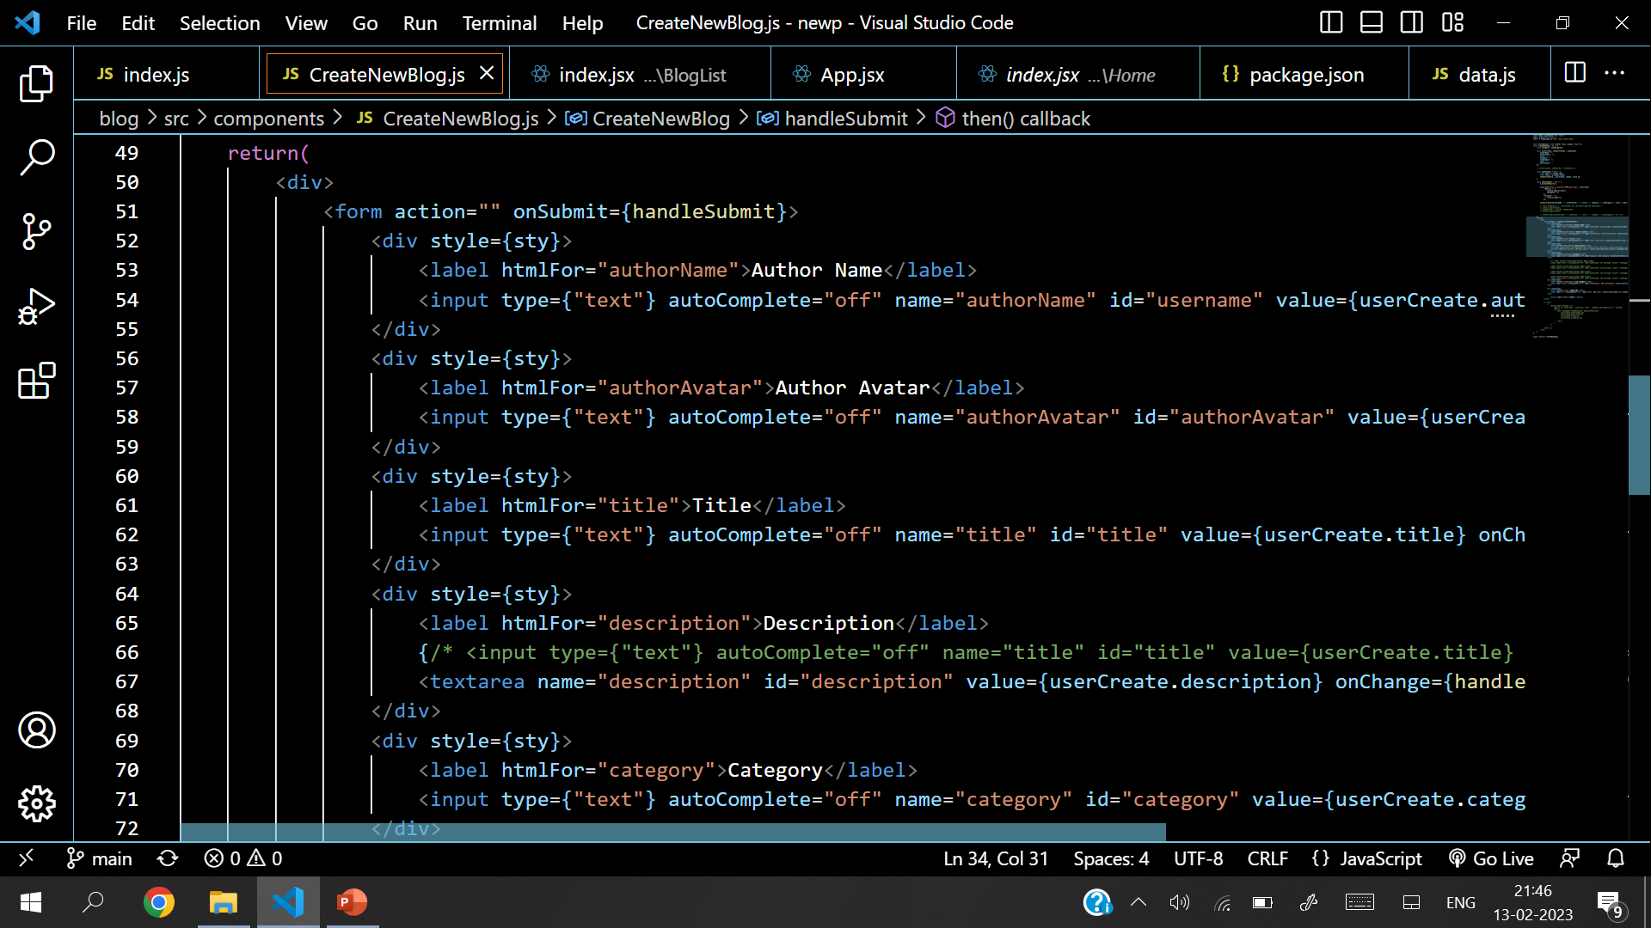
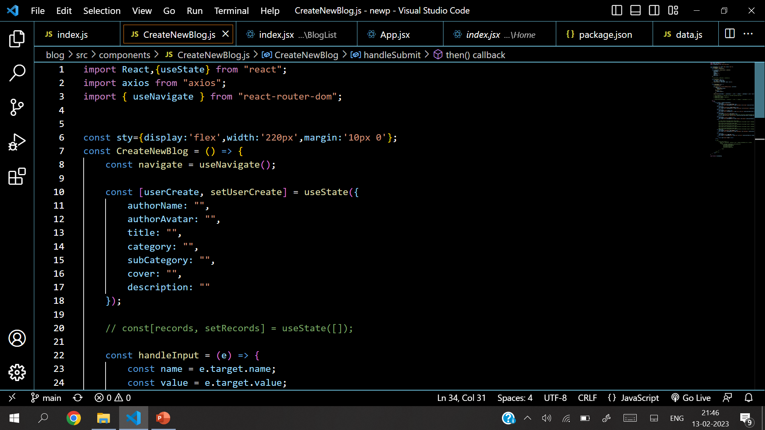
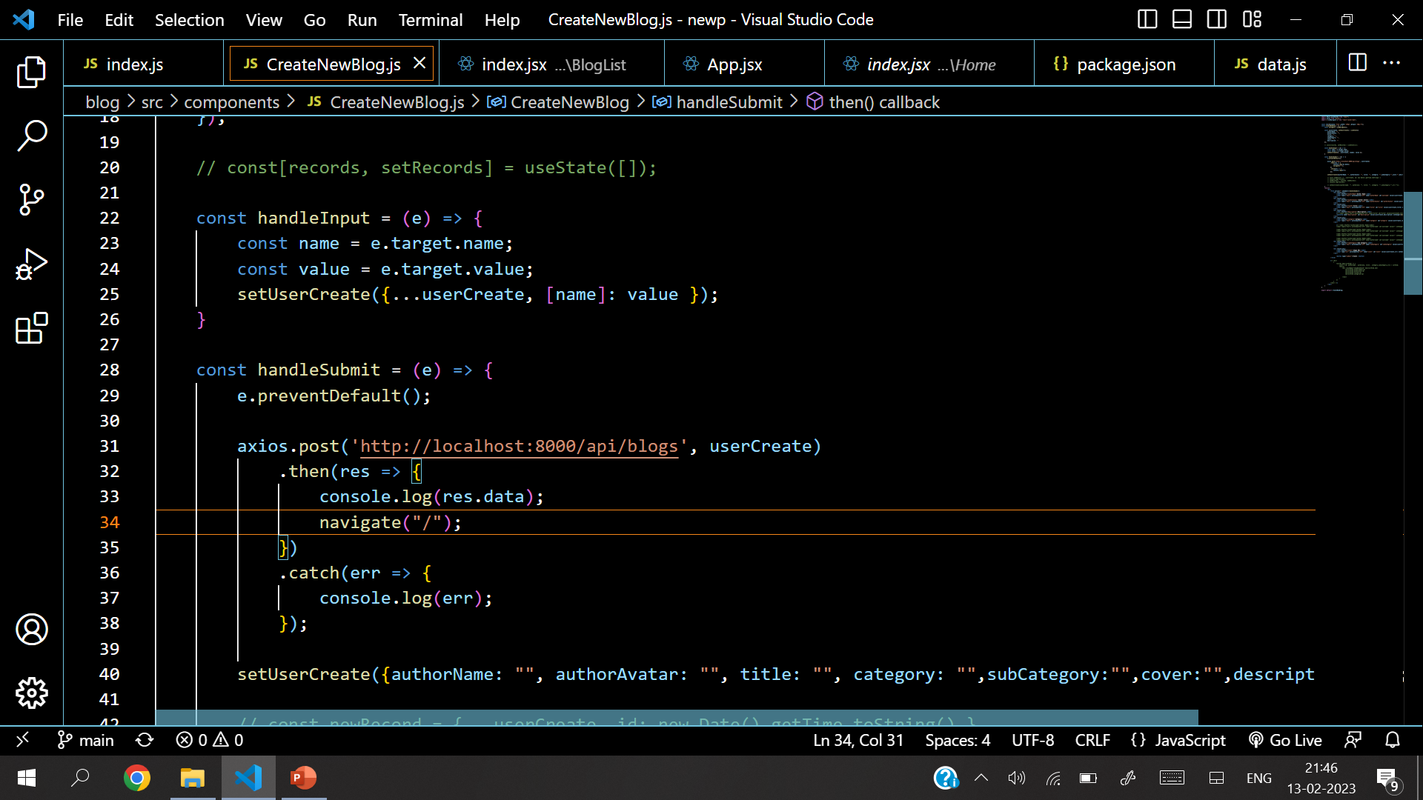
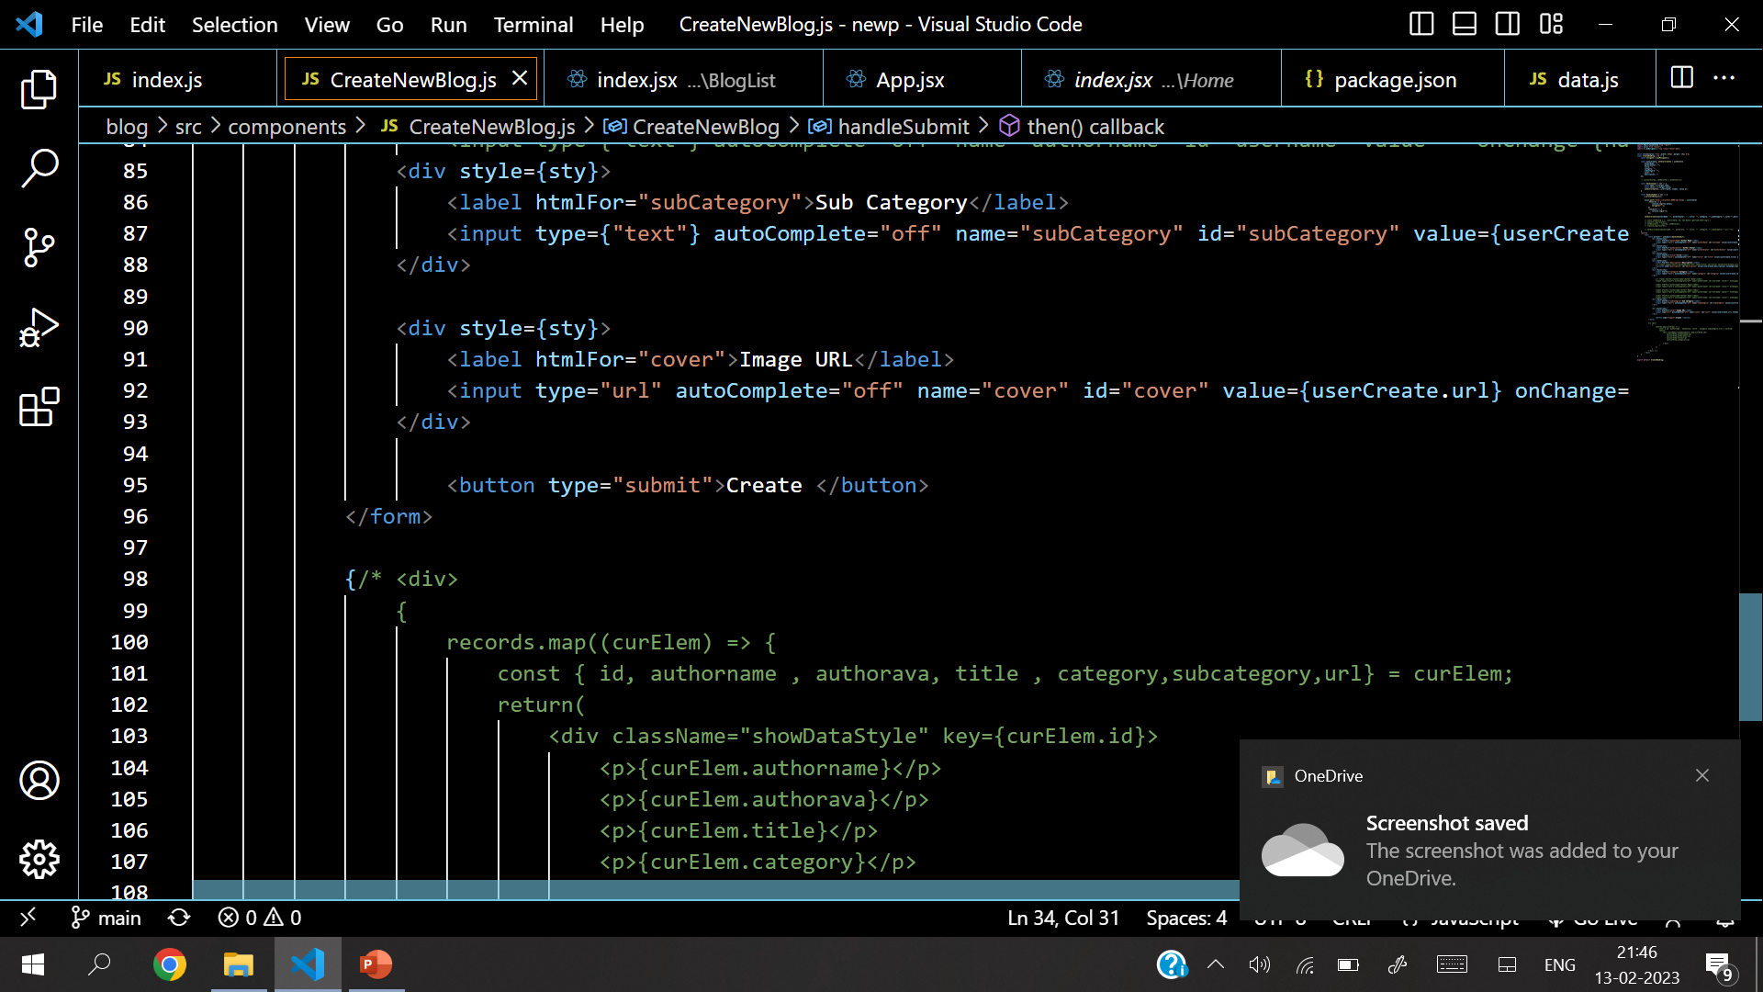
Source Code

Slide 12
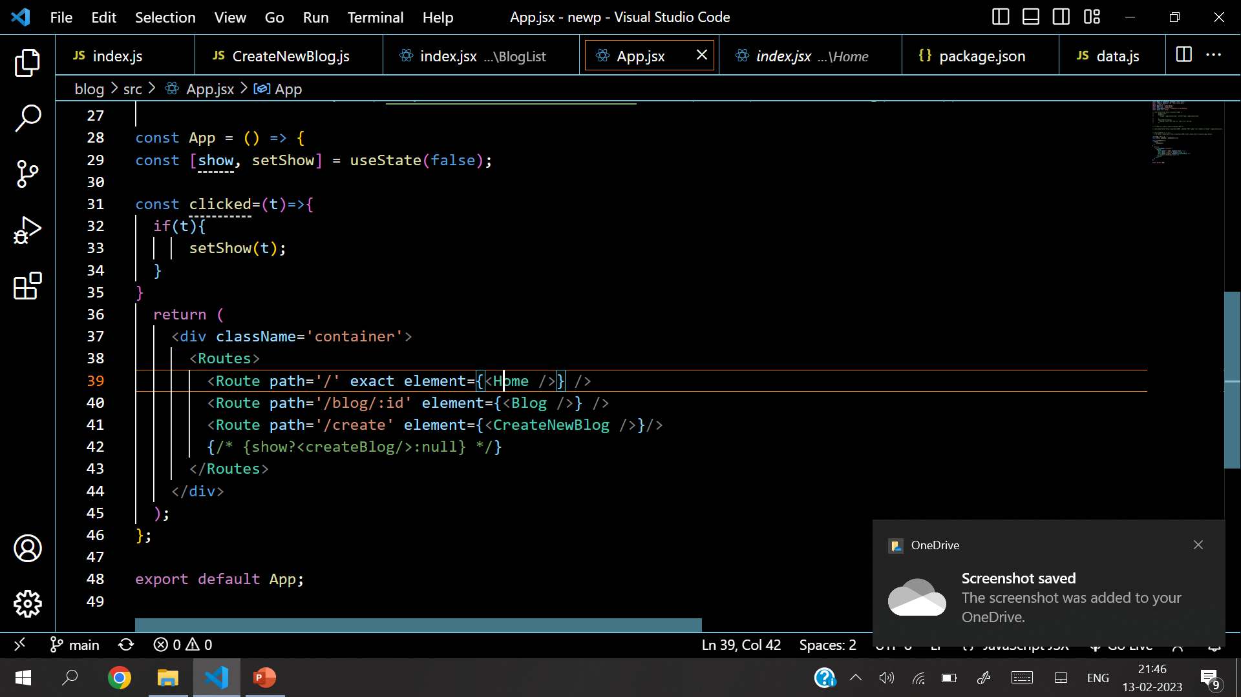
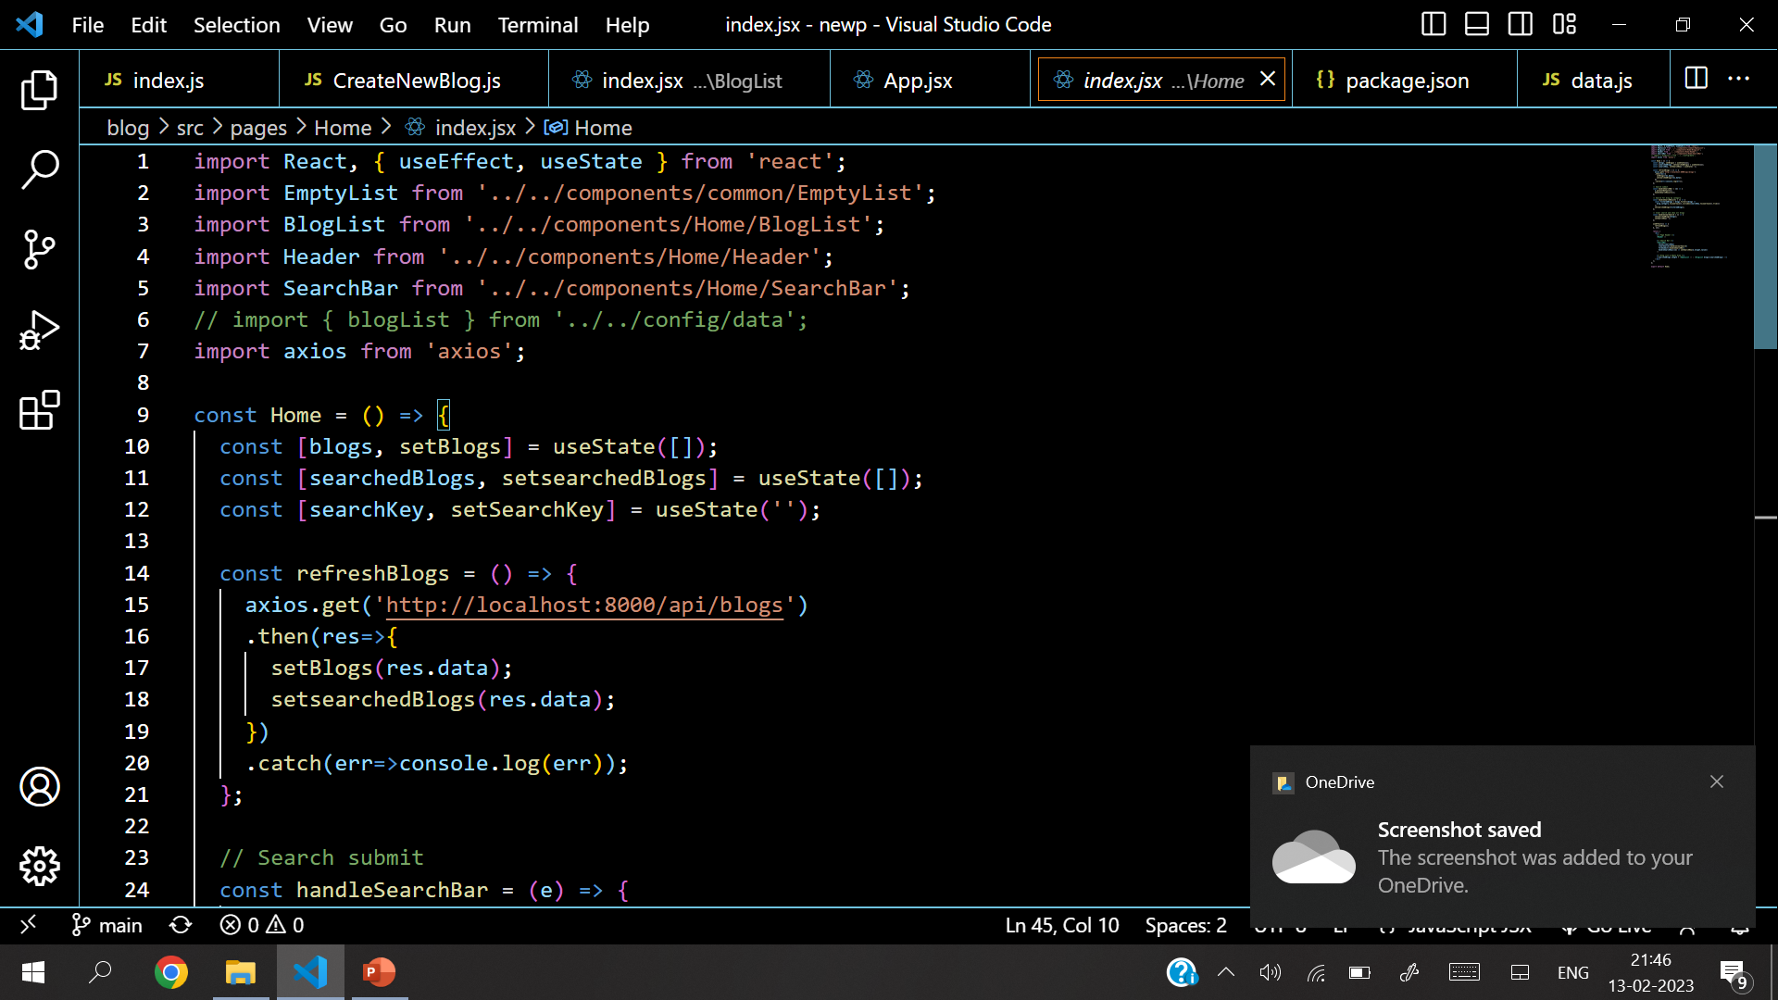
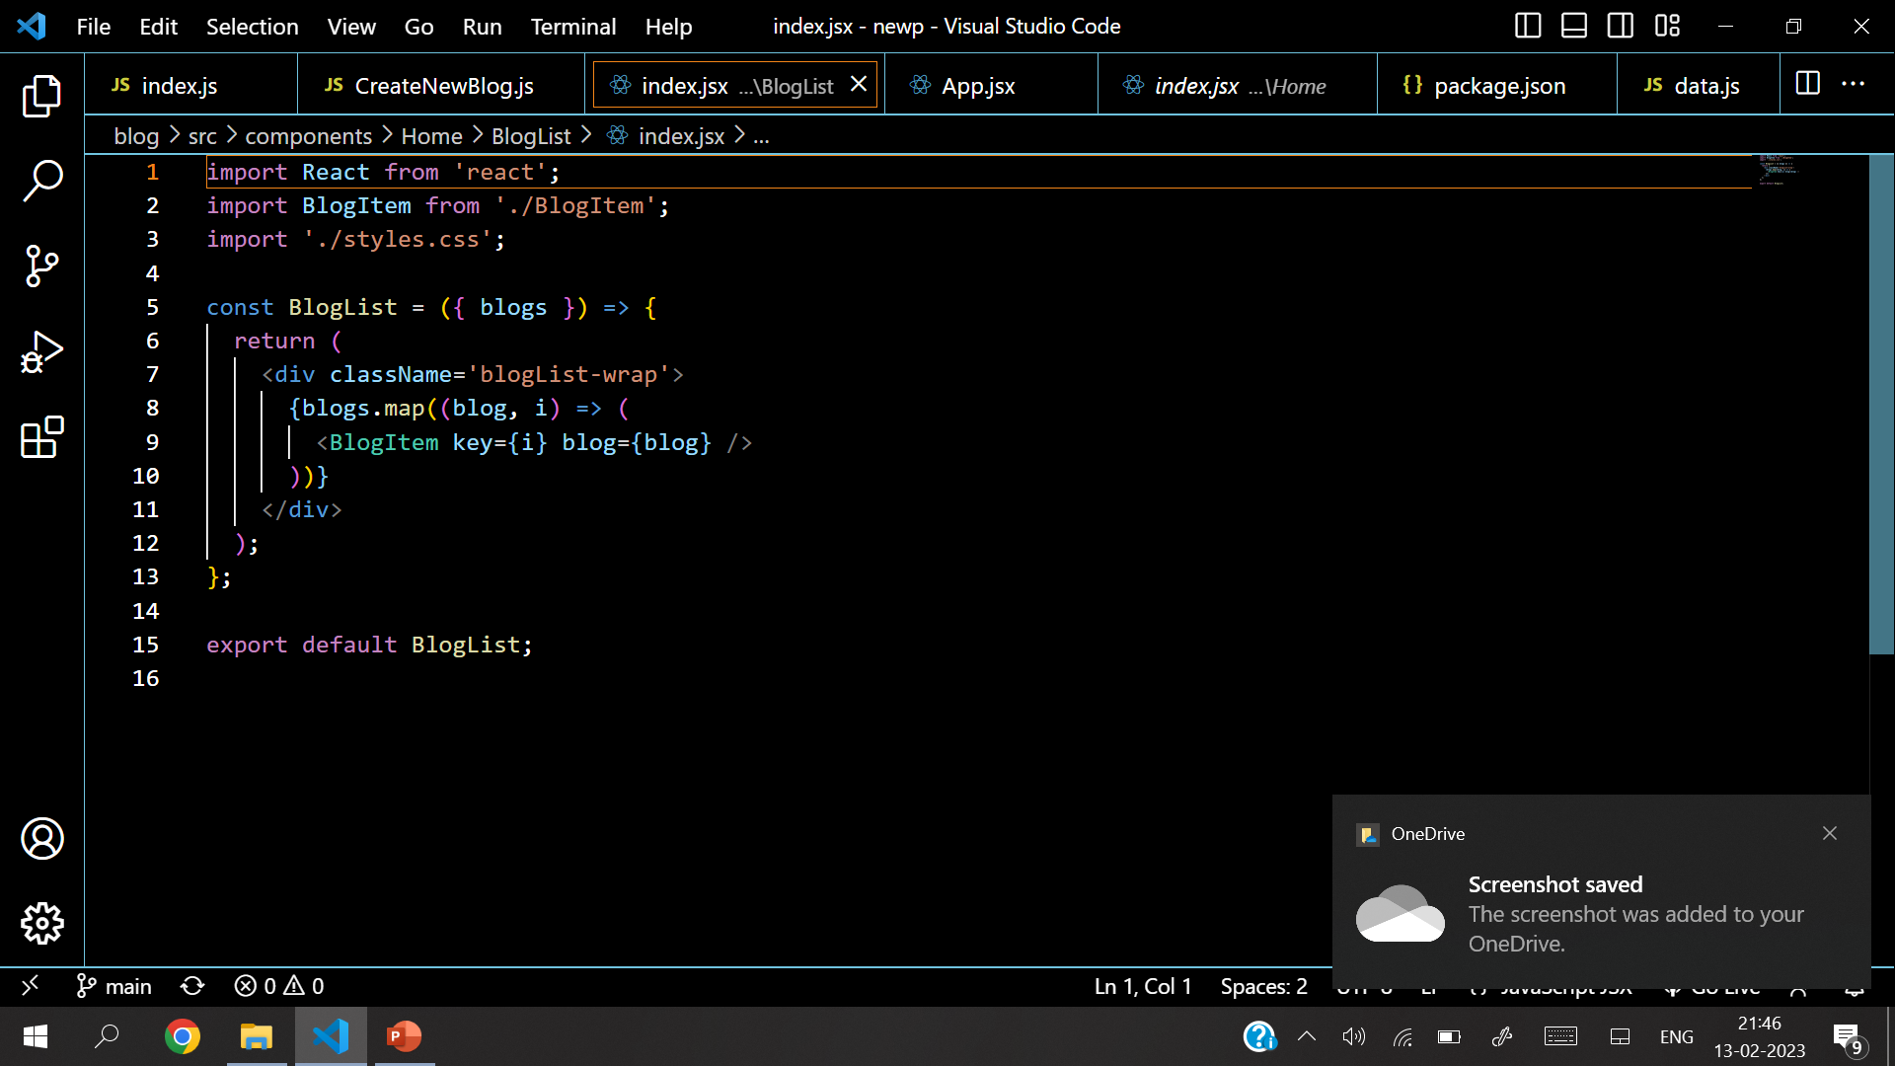
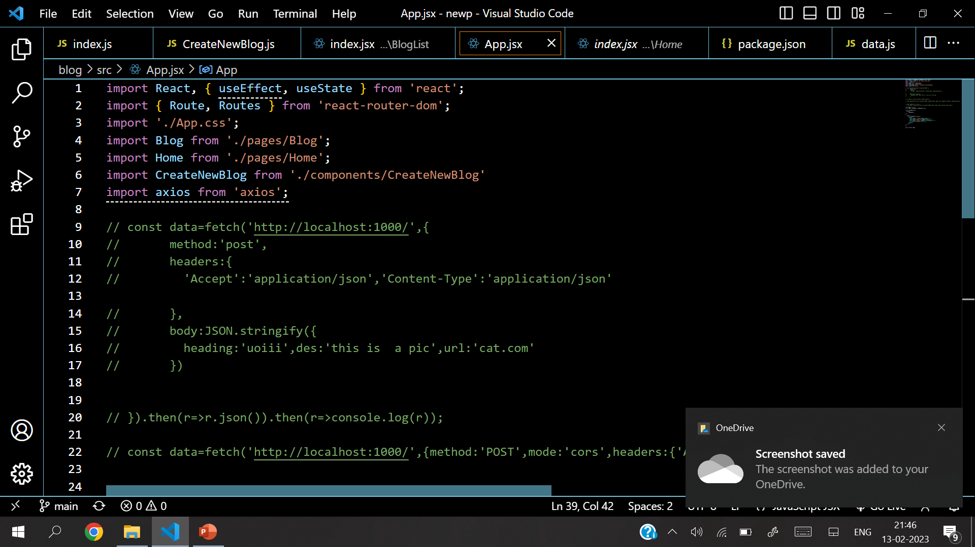
Source Code

Slide 13
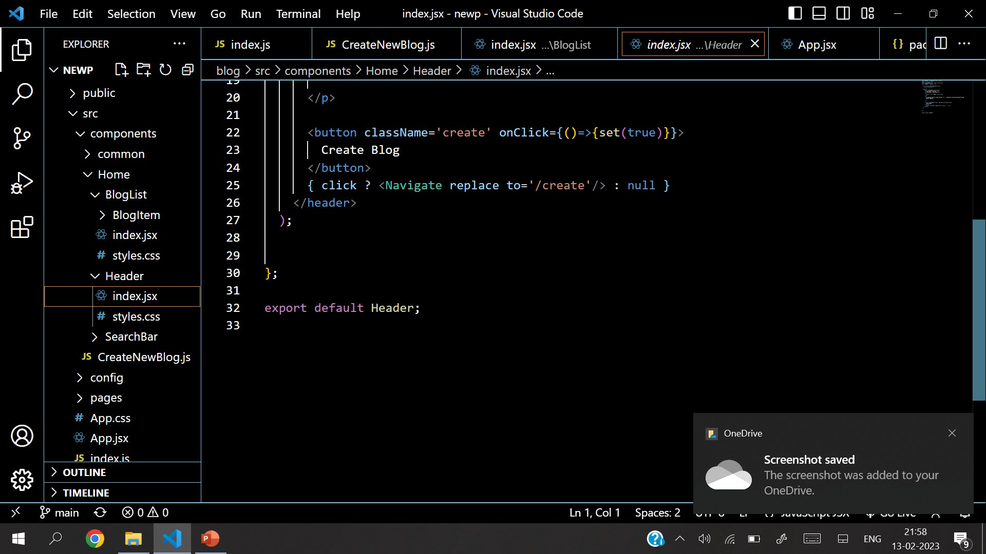
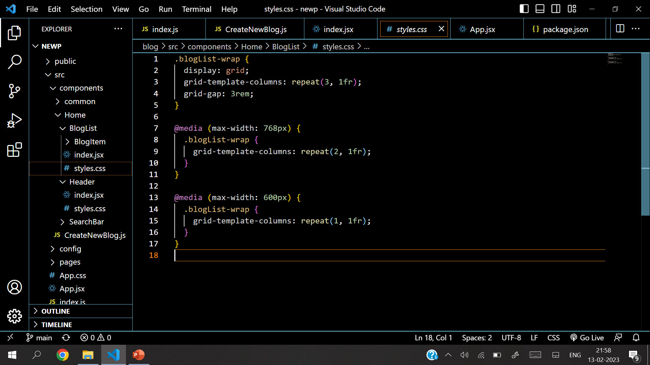
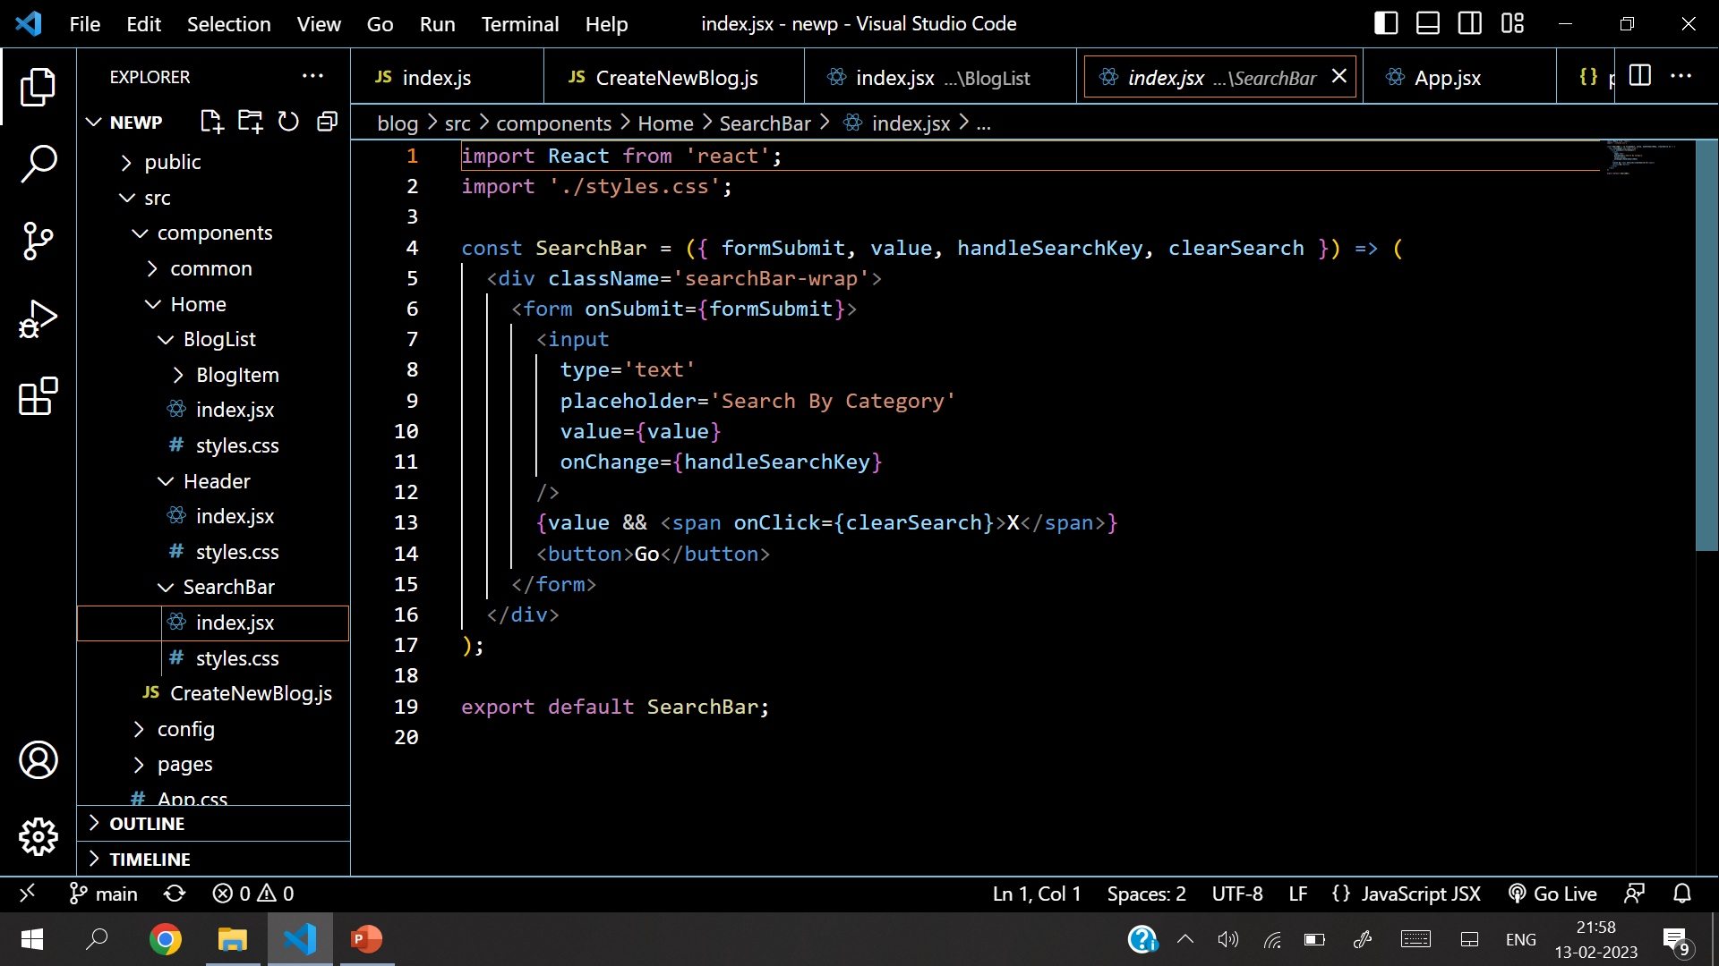
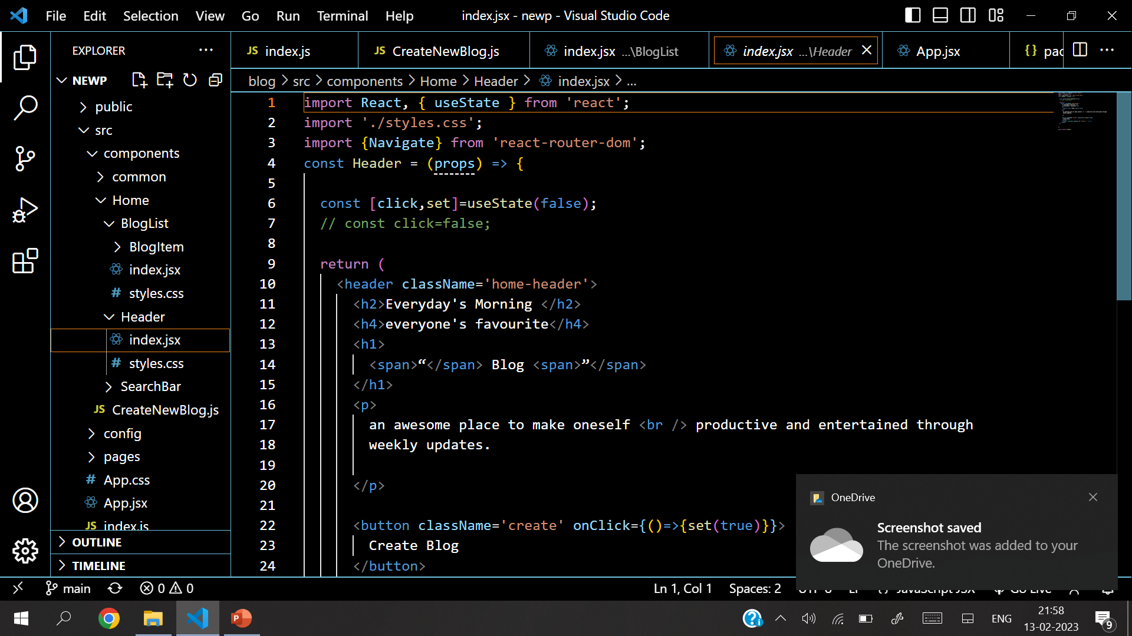
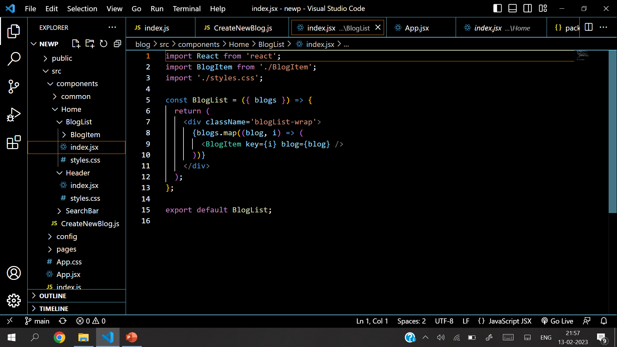
Source Code

Slide 14
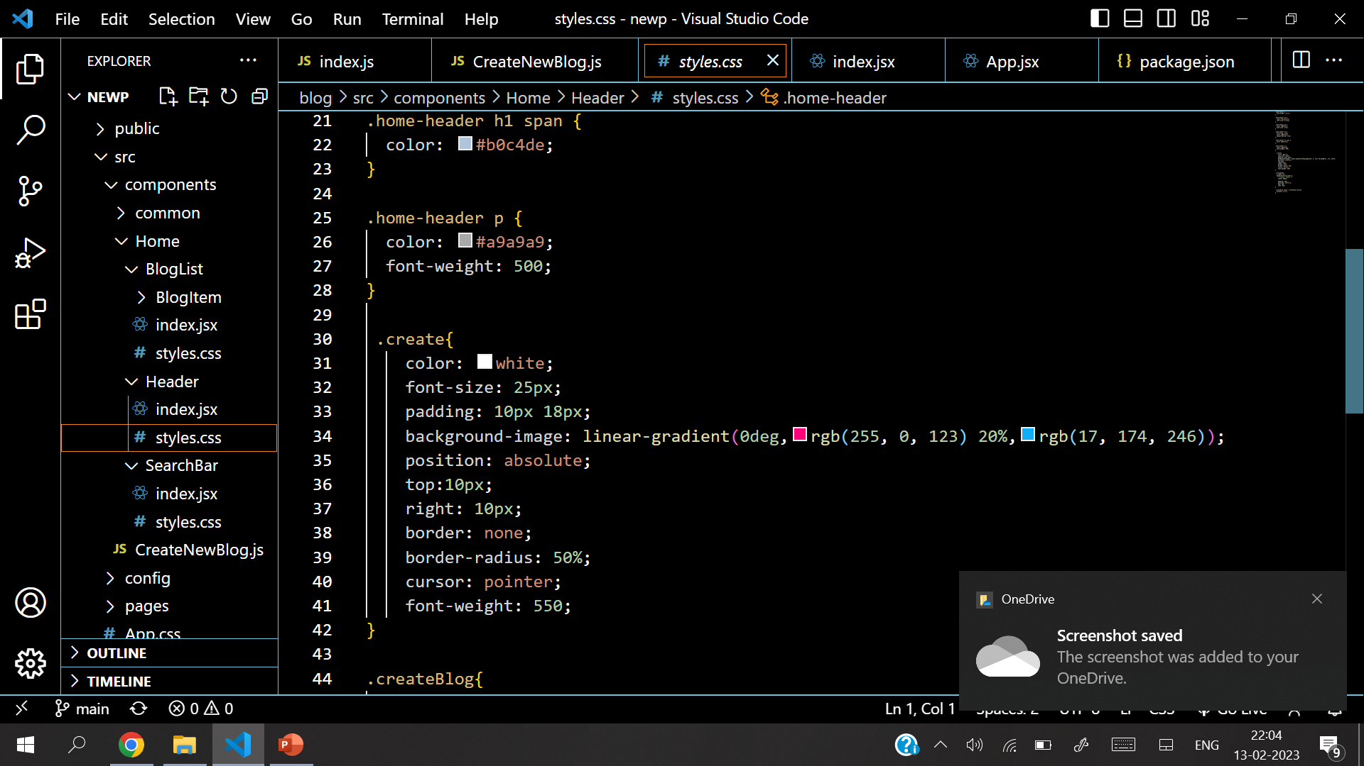
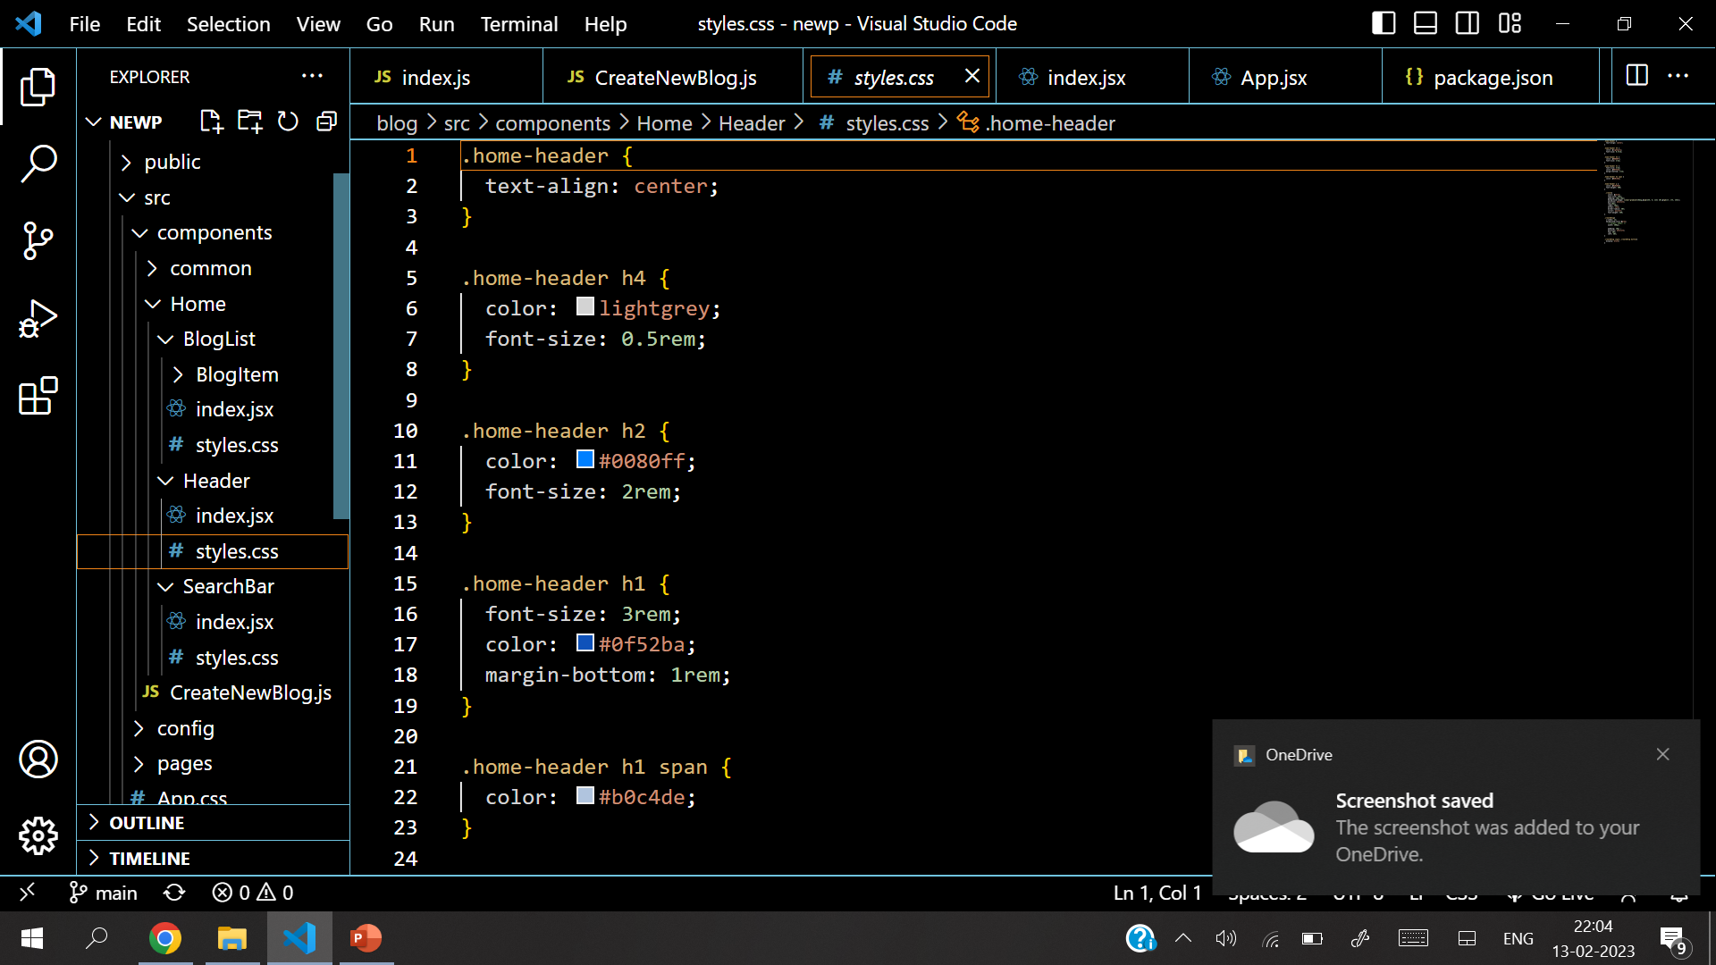
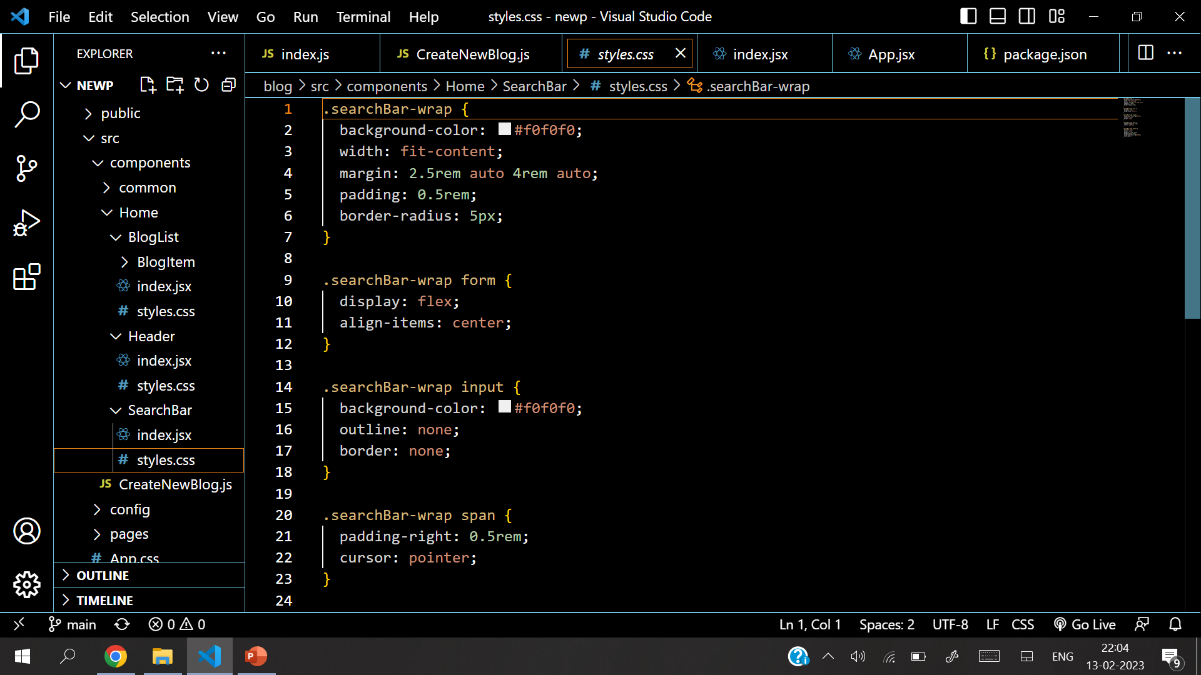
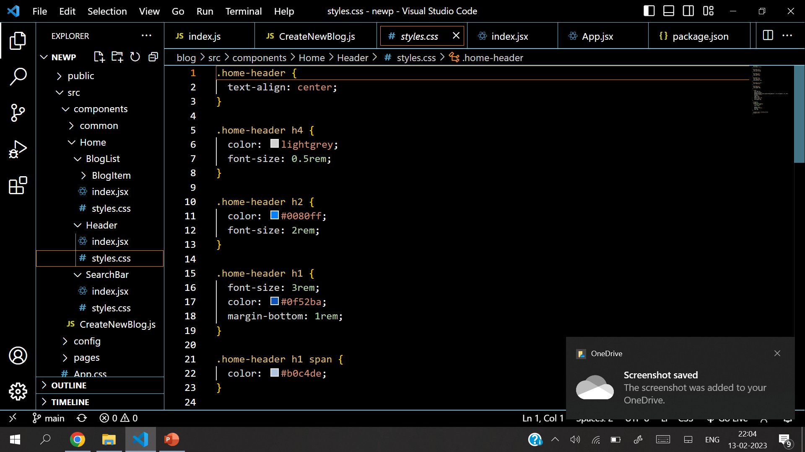
Source Code

Slide 15
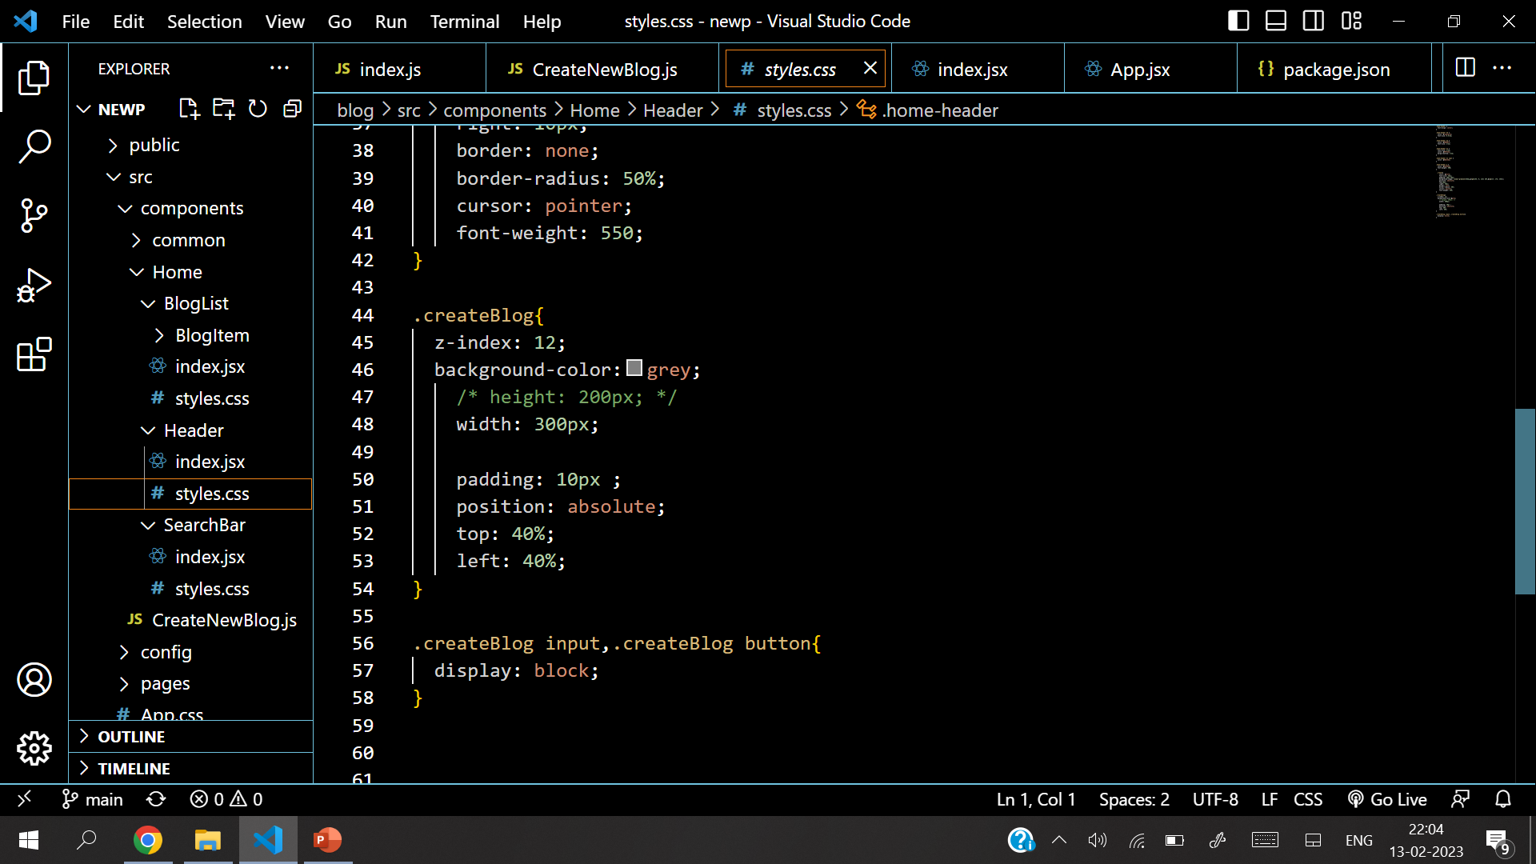
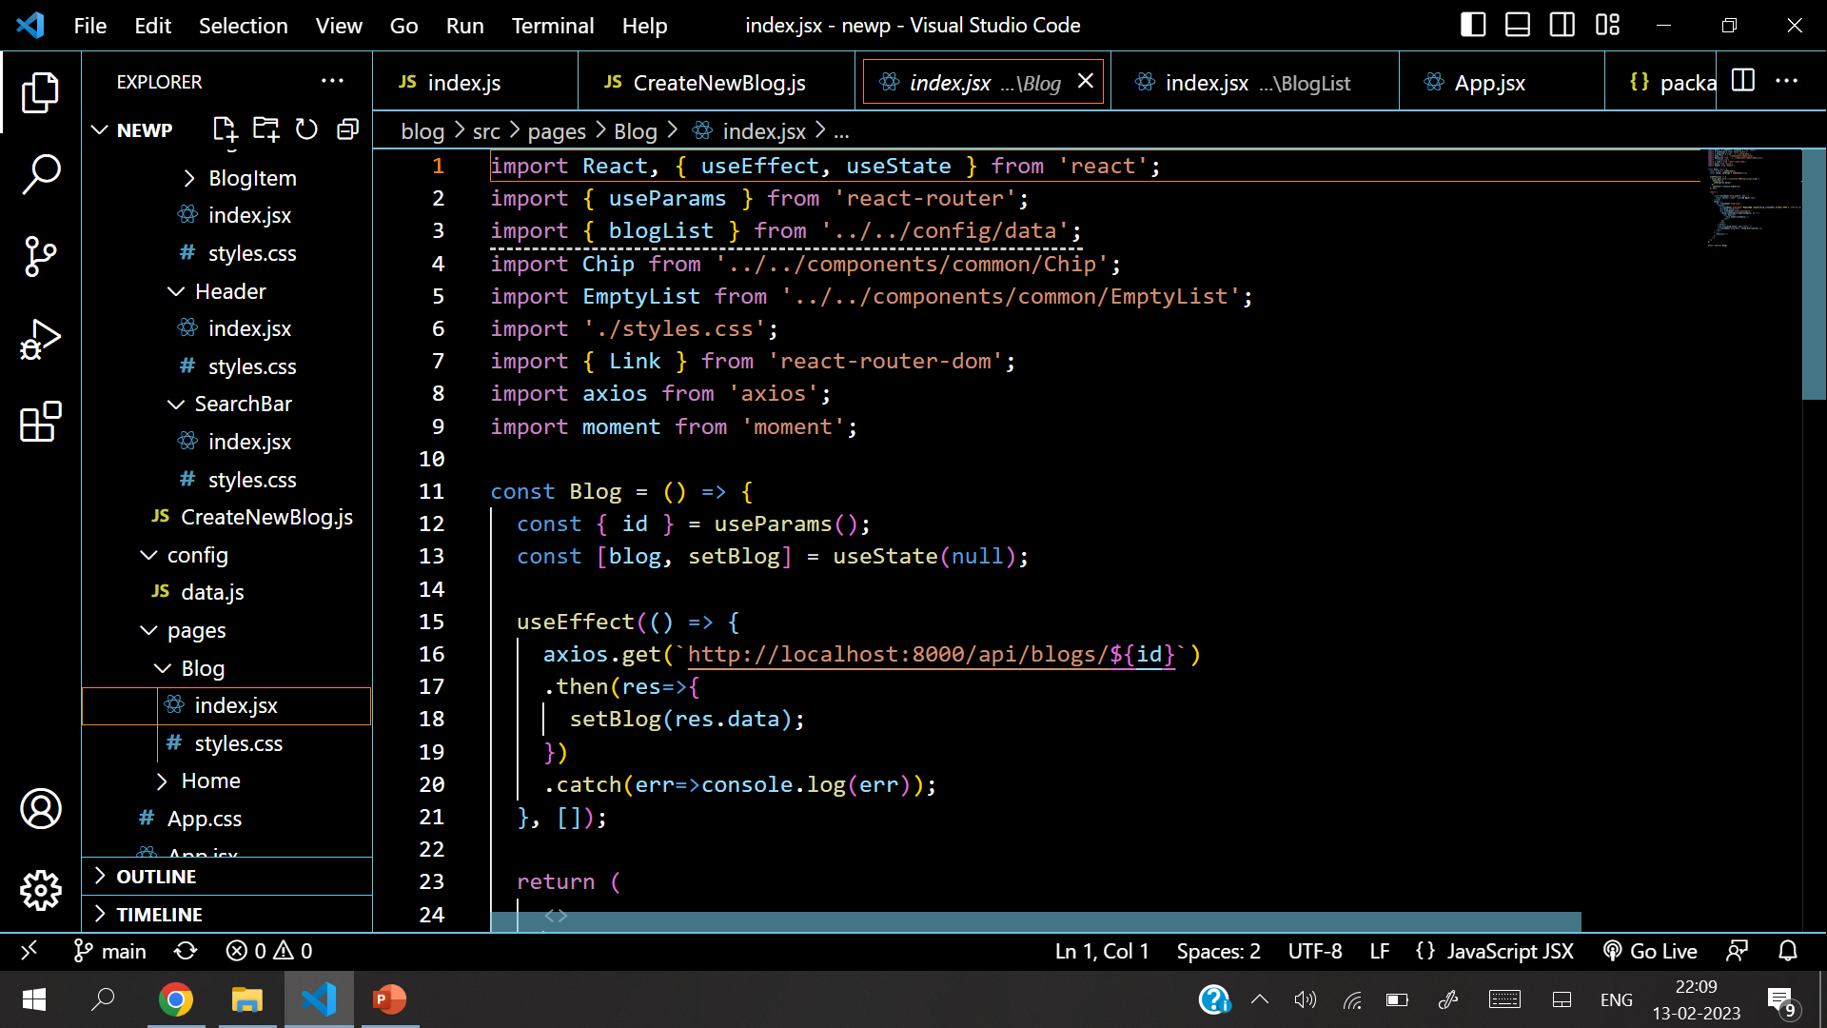
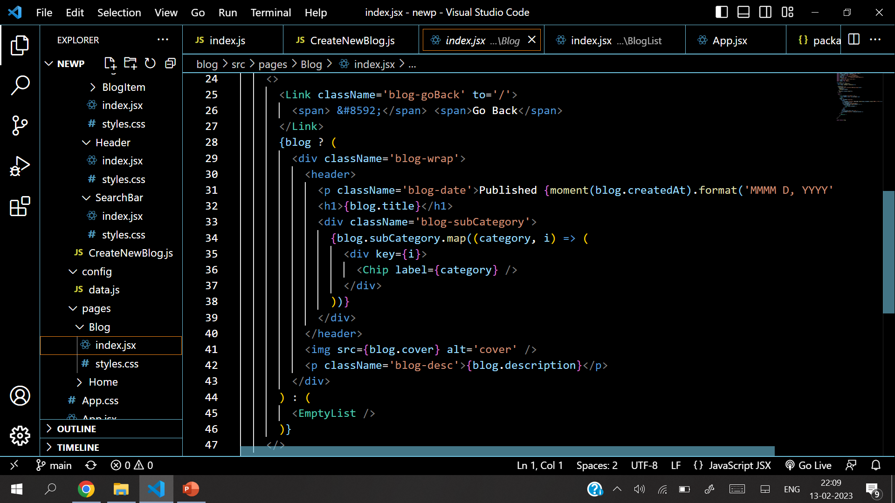
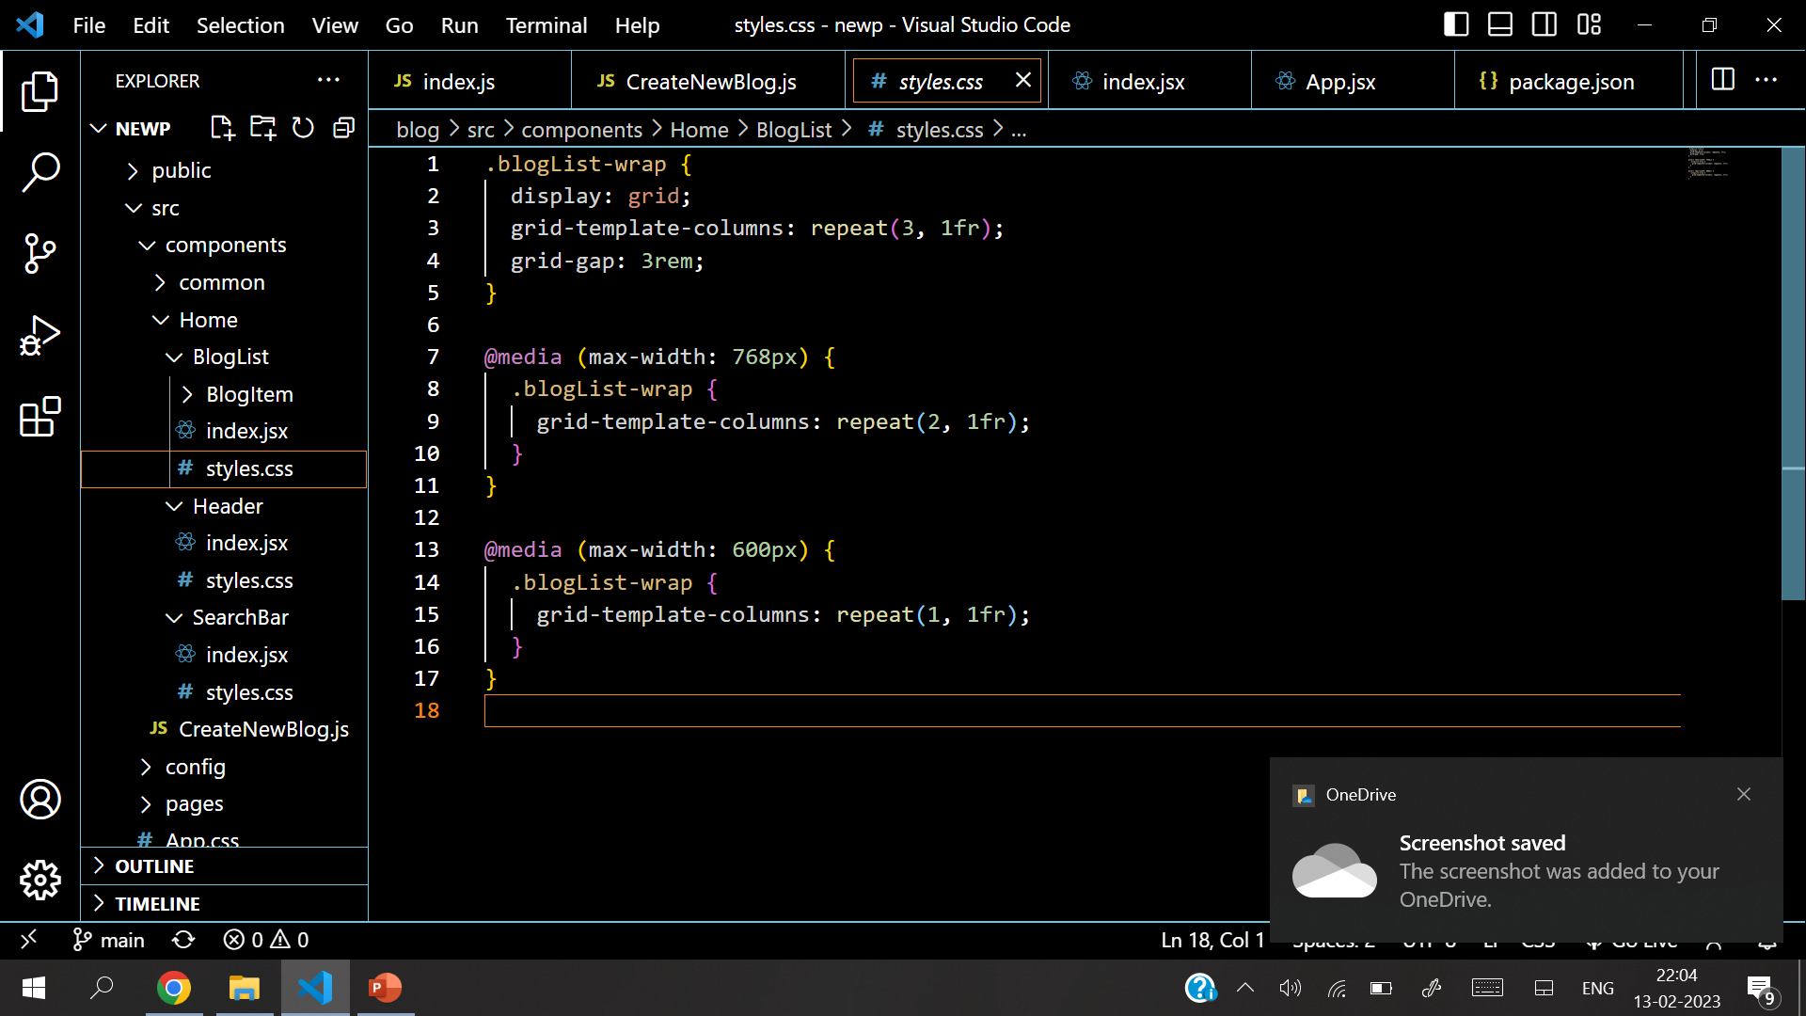
Source Code

Slide 16
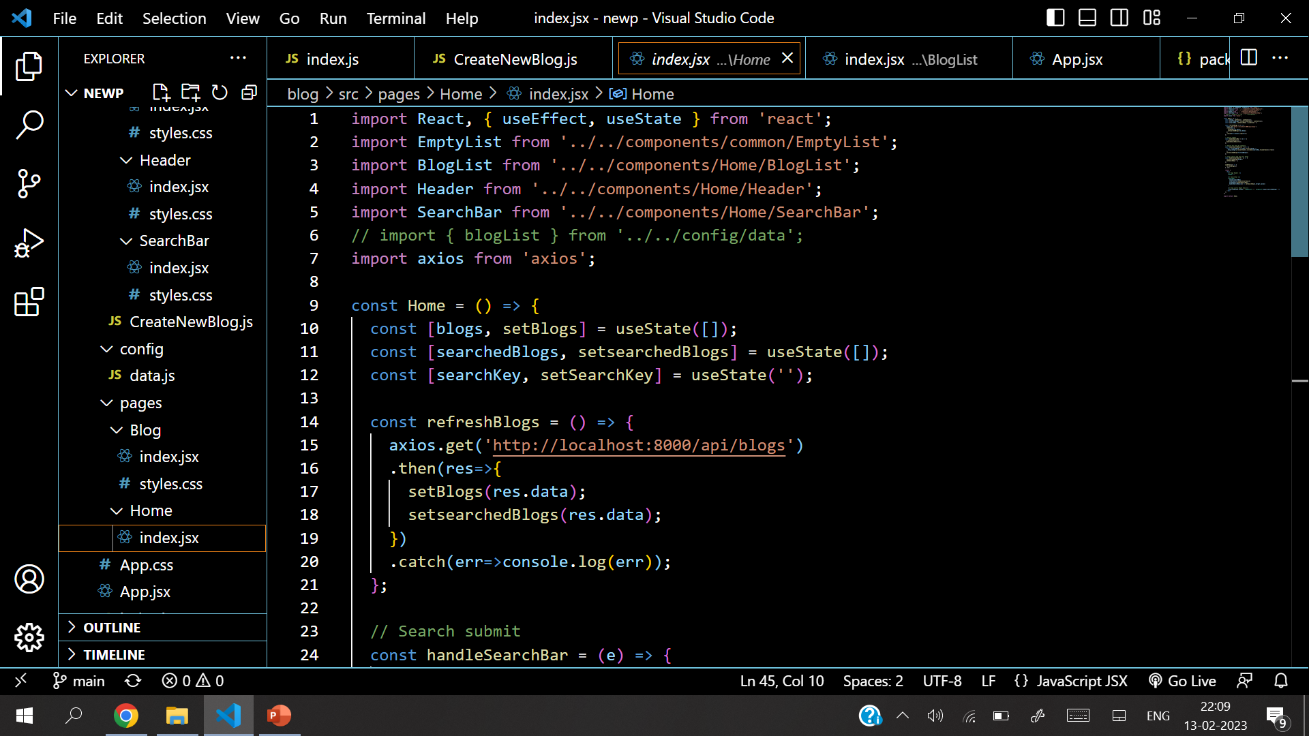
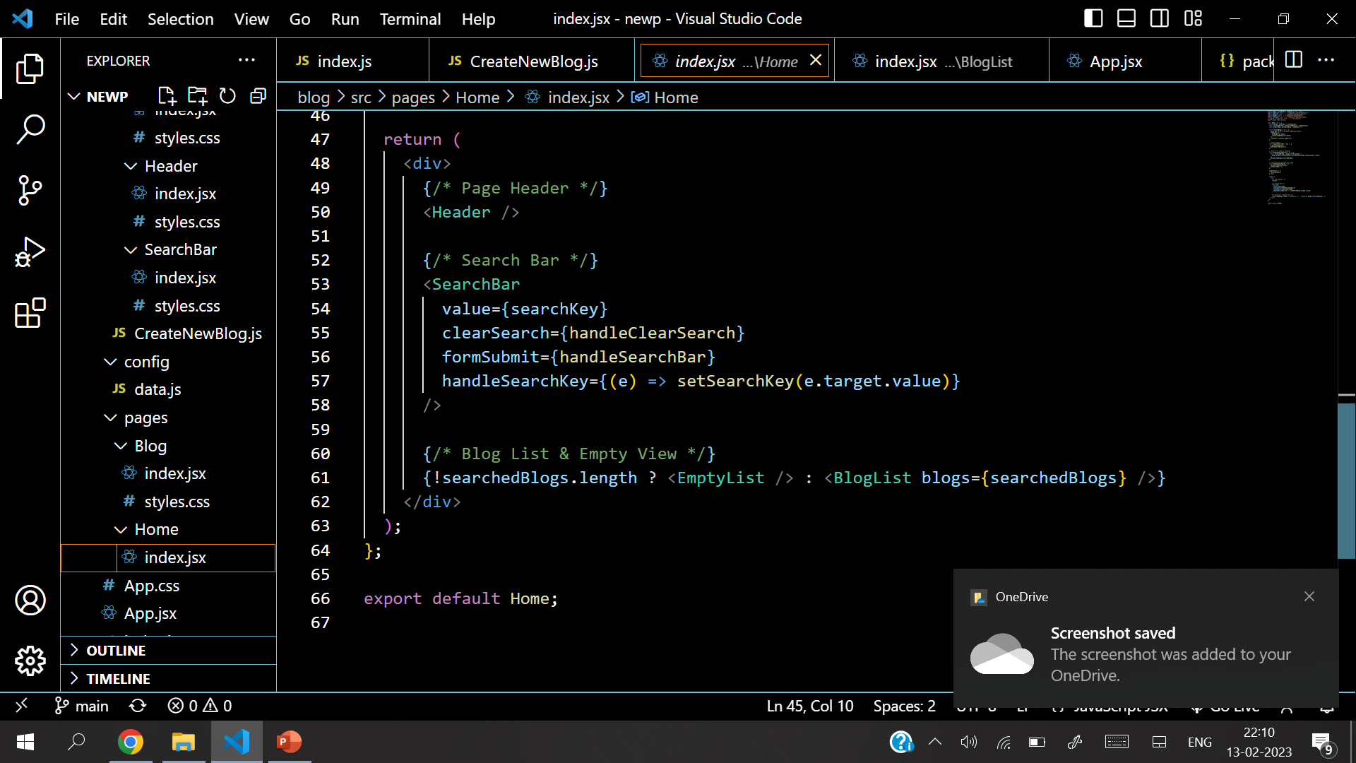
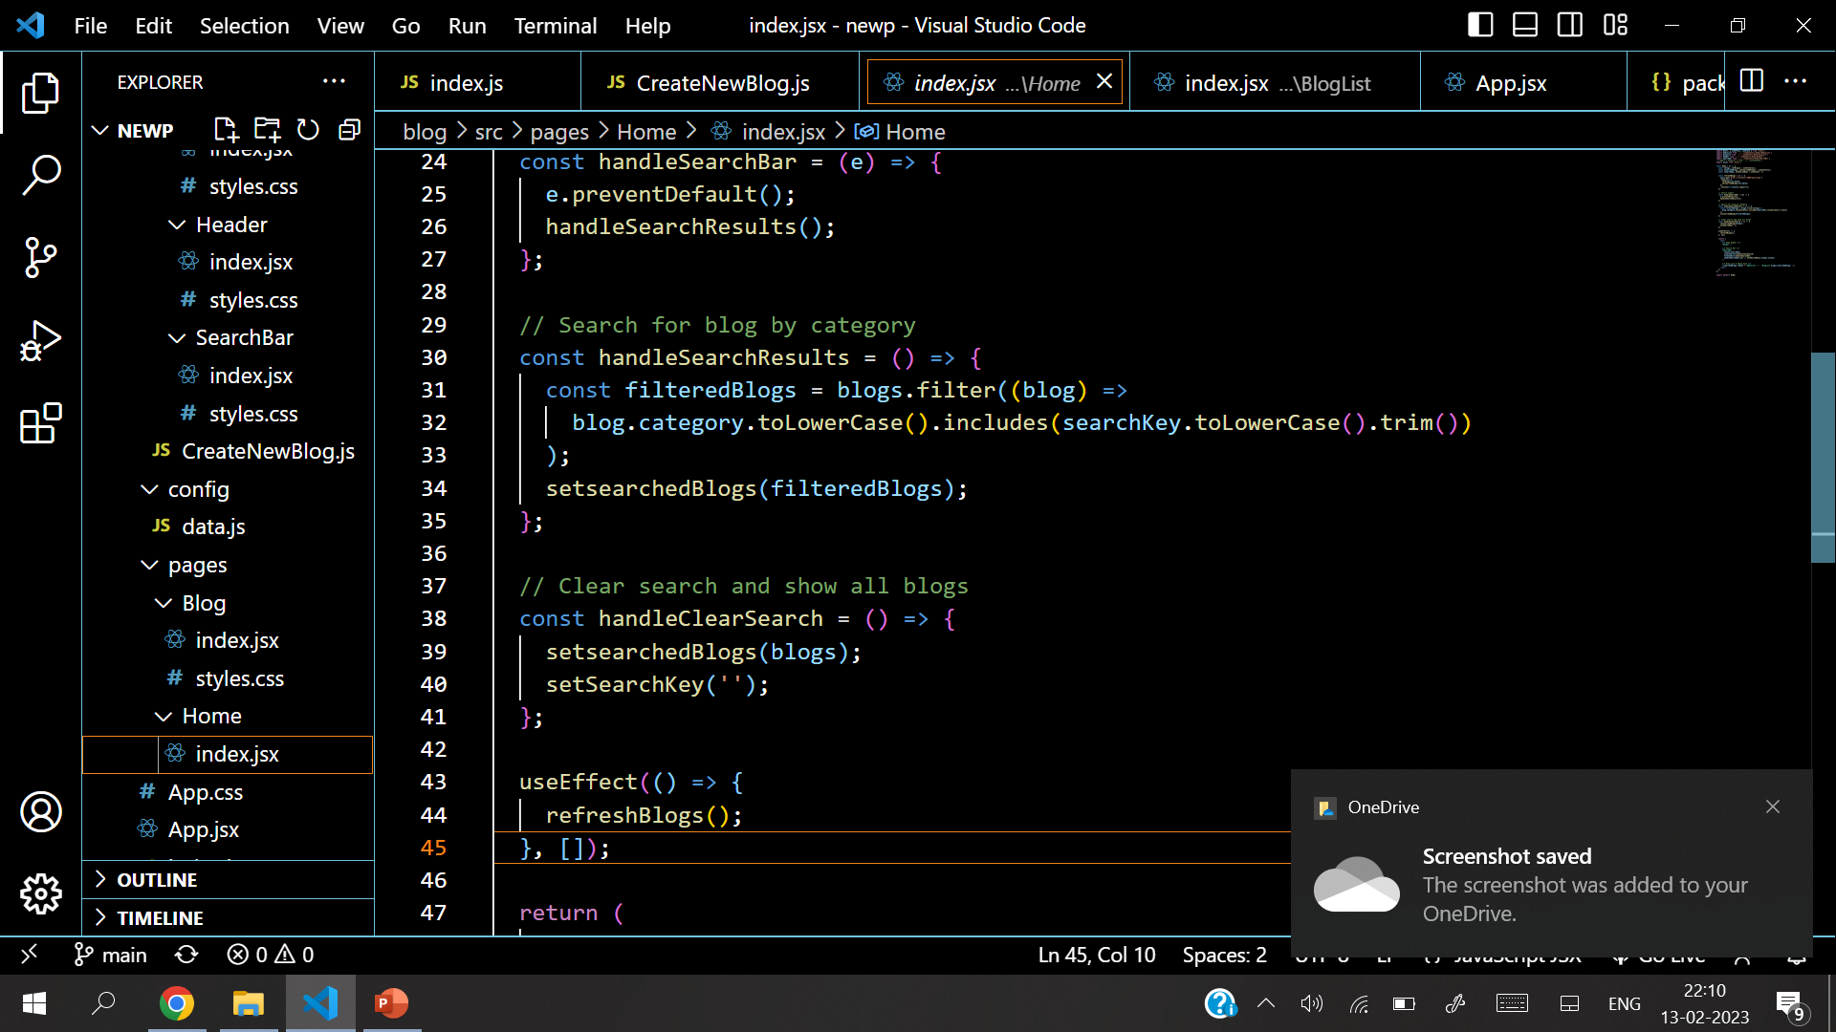
Source Code

Slide 17
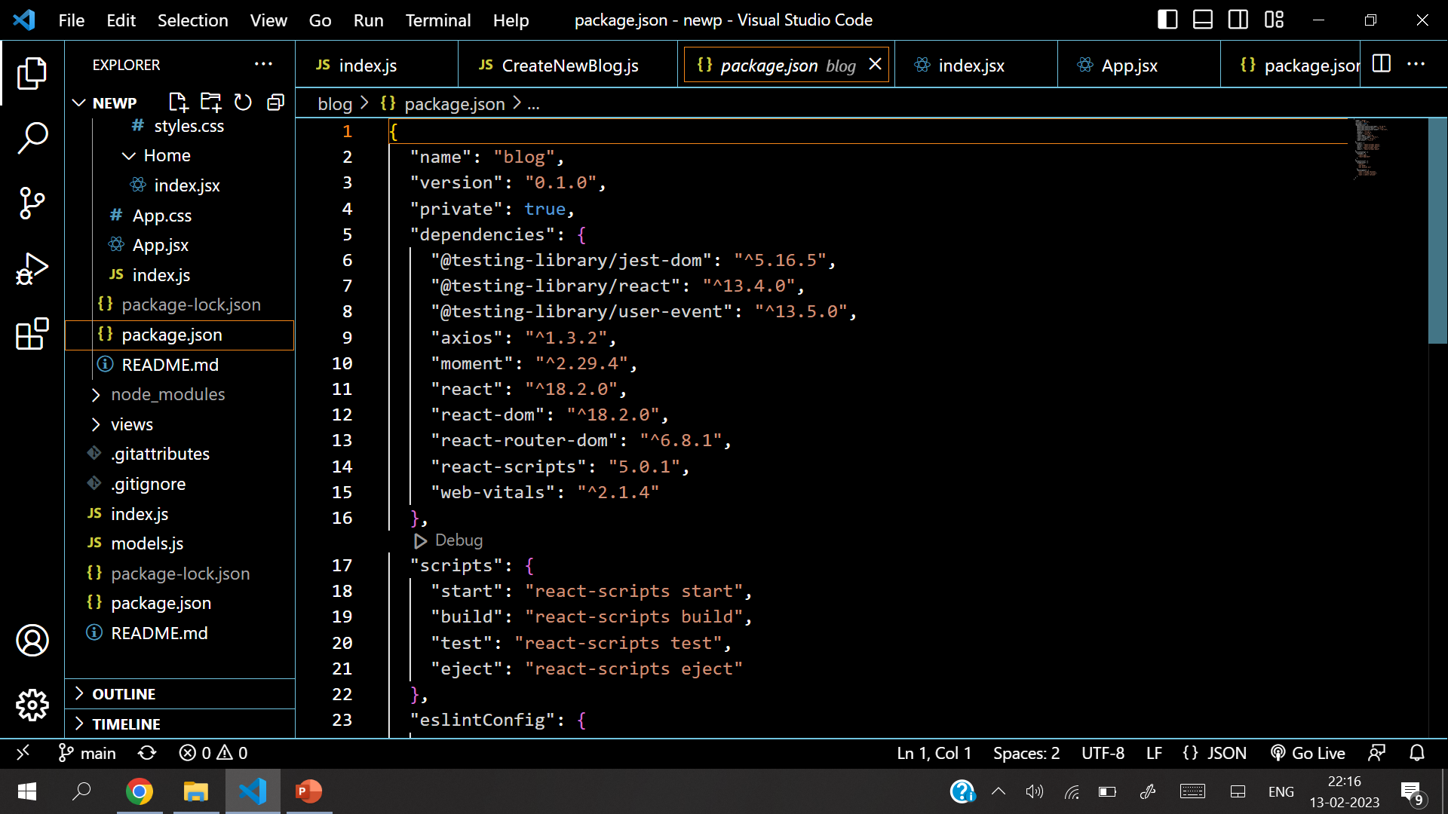
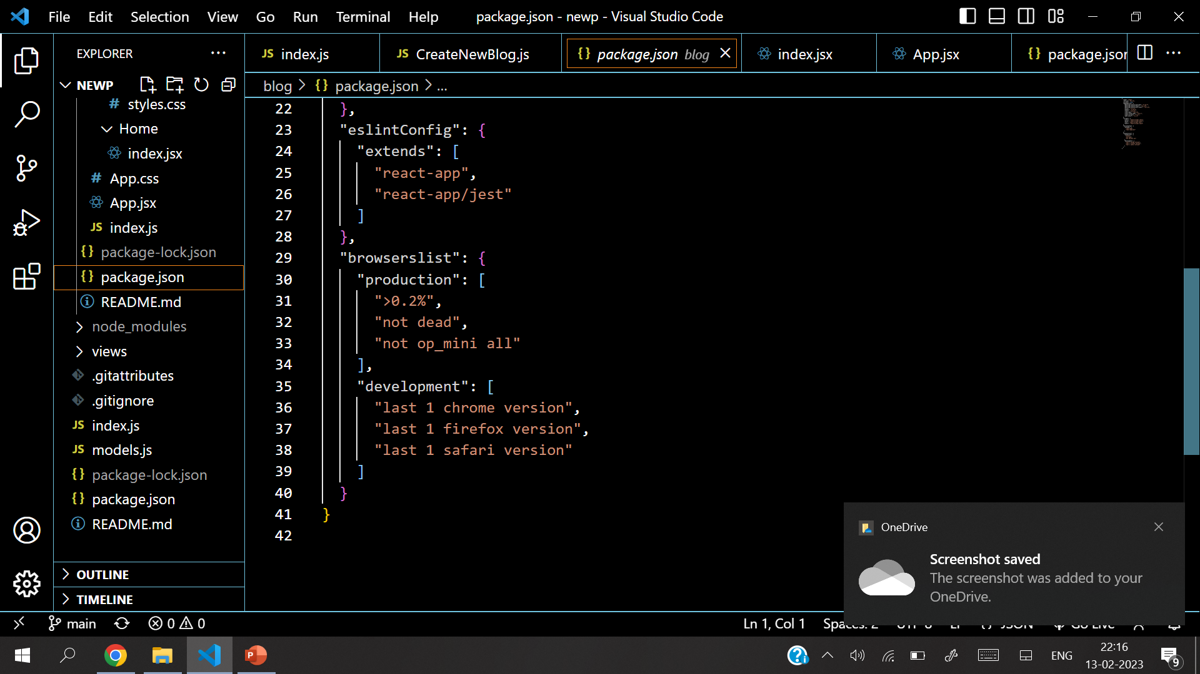
Source Code

Slide 18
Future Work
Since with the basic working of the page this project still needs a lot of improvements and enhancements:
Fgngf
Dhdh
Dfhdh
Dfhdh
Dhd
h {EDITTTTTT}
Code links

Slide 19
Bibliography
https://www.w3schools.com
https://www.github.com
https://www.youtube.com
https://www.javascripttutorial.net
https://www.mongodb.com
https://www.reactjs.com

Slide 20
Thank You

